Slide 1

Ramrao Adik Institute of Technology
Department of Computer Engineering
BE Major Project
Abstract Presentation
By
Roll No. Name of Students
21CE1471 Ashish Kesarkar
21CE1102 Sujal Paunikar
21CE1551 Amisha Khorwal

Slide 2
Outline
Introduction
Literature Survey
Idea of Implementation
Scope of the Project
References

Slide 3
Topic 1 : AI-Driven Crop Disease Prediction and Management
Introduction : Agriculture plays a crucial role in food production, but crop diseases are a major challenge for farmers. Early detection and proper management of plant diseases are essential to prevent crop loss and ensure food security. Traditionally, farmers rely on manual observation to identify diseases, which can be time-consuming and inaccurate. However, Artificial Intelligence (AI) is transforming agriculture by providing smart solutions for disease prediction and management.
AI-powered systems use advanced technologies like machine learning and image processing to detect plant diseases at an early stage. By analyzing images of affected crops, AI models compare them with a database of known diseases and provide accurate identification.

Slide 4
Topic 1 : AI-Driven Crop Disease Prediction and Management
Literature Survey
Reference | Study Description | Key Findings
Deep Learning for Plant Disease Detection (2023) | This paper discusses the use of deep learning techniques, such as Convolutional Neural Networks (CNNs), to identify crop diseases from leaf images. It highlights the role of AI in improving accuracy and reducing dependency on manual disease identification. | CNN-based models achieve high accuracy in classifying plant diseases. The study reports an accuracy of 98% for tomato leaf disease detection using ResNet-50.
Machine Learning-Based Crop Disease Prediction (2022) | The study explores the use of machine learning algorithms, including Support Vector Machines (SVM) and Random Forest (RF), to classify plant diseases. It compares multiple models on various datasets to determine the most effective approach. | Random Forest achieves an accuracy of 94.6%, outperforming SVM (91.8%). The study suggests combining multiple models for improved performance.

Slide 5
Topic 1 : AI-Driven Crop Disease Prediction and Management
Literature Survey
Reference | Study Description | Study Description
AI and IoT for Smart Farming Disease Management (2021) | This research integrates AI with IoT devices such as drones and sensors to monitor plant health in real time. It discusses how AI-powered decision-making helps in early disease detection and prevention. | AI-IoT integration allows real-time monitoring, reducing crop loss by 30%. Drones equipped with AI models detect diseases with an accuracy of 96%.
Mobile-Based Crop Disease Diagnosis Using AI (2020) | The paper focuses on mobile applications powered by AI that assist farmers in diagnosing crop diseases by uploading images. It highlights how AI can make disease detection accessible to small-scale farmers. | Mobile AI apps detect diseases with 92% accuracy. Farmers benefit from quick, automated diagnoses, reducing dependency on experts.

Slide 6
Topic 1 : AI-Driven Crop Disease Prediction and Management
Literature Survey
Reference | Study Description | Study Description
AI-Based Predictive Analytics for Crop Disease Forecasting (2019) | This study examines AI-driven predictive models that use environmental data, such as temperature and humidity, to forecast disease outbreaks before they occur. | Predictive analytics models achieve an accuracy of 90%, allowing farmers to take preventive actions before disease spreads.

Slide 7
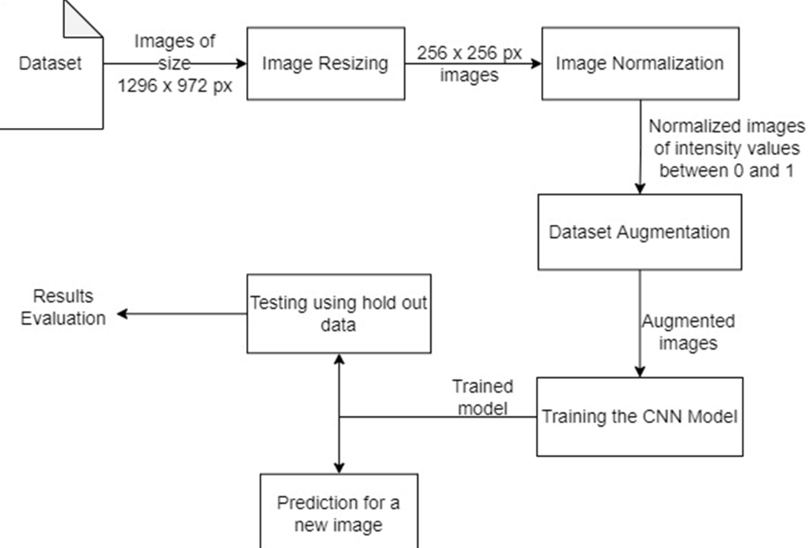
Topic 1 : AI-Driven Crop Disease Prediction and Management
Idea of Implementation

Slide 8
Topic 1 : AI-Driven Crop Disease Prediction and Management
The AI-based crop disease prediction system leverages machine learning and deep learning models to accurately identify and classify plant diseases, helping farmers take timely action to prevent yield loss. By analyzing real-time images of crops, the system detects symptoms of diseases at an early stage, minimizing the risk of widespread infection. It utilizes extensive datasets of healthy and diseased plants to improve prediction accuracy and adaptability to various crop types and environmental conditions.
Real-Time Disease Detection & Analysis: The system processes images of crops using AI algorithms to detect and classify diseases with high precision, providing early warnings for effective intervention.
Scalability & Accessibility: Designed for scalability, the model can be deployed via mobile apps, IoT-enabled devices, or cloud platforms, making it accessible to farmers worldwide.
Adaptive Learning & Recommendation System: The AI continuously improves through new data inputs while providing actionable insights and treatment recommendations to enhance crop health and productivity.

Slide 9
Topic 2 : AI Based Fitness platform
Introduction:
Introducing FitAI, the ultimate AI-powered fitness platform designed to revolutionize your health and wellness journey. Whether you're looking to achieve your fitness goals, improve your posture, or follow a personalized diet plan, FitAI has you covered.
Our advanced AI algorithms analyze your body type, fitness level, and preferences to recommend tailored workouts and meal plans that maximize results. With AI-driven workout training and real-time posture correction, you can ensure proper form, reduce injury risks, and optimize performance—all from the comfort of your home. Take the guesswork out of fitness and let AI guide you toward a healthier, stronger you!

Slide 10
Literature Survey
Reference | Study Description | Key findings
"AI-Based Fitness Trainer" International Journal of Innovative Research in Technology | This study explores the potential of AI in providing individualized fitness training. It discusses how AI-based fitness trainer applications can offer personalized and adaptive training regimens tailored to individual needs. | AI-based fitness trainers can deliver customized workout plans by analyzing user data, leading to more effective and engaging fitness experiences. The study also highlights challenges and future prospects in AI-based fitness training.
"Virtual Fitness Trainer Using AI: A Research Paper" International Journal for Research in Applied Science & Engineering Technology | - Develops a virtual fitness trainer using AI. | - Provides personalized workout guidance and real-time feedback.

Slide 11
Literature Survey
Reference | Study Description | Key findings
"A Review on: Body Posture Detection and Motion Tracking using AI for Fitness Applications" Journal of Emerging Technologies and Innovative Research | - Proposes a system to assist individuals in performing exercises with proper posture. | - Uses pose estimation to determine workout posture and offers improvement recommendations.
"AI-Based Workout Assistant and Fitness Guide" International Journal of Engineering Research & Technology | - Presents a system that tracks body movements and provides real-time posture detection and diet recommendations. | - Guides users on exercises, ensures correct posture, and counts repetitions using computer vision.

Slide 12
Literarture Survey
Reference | Study Description | Key findings
"An Artificial Intelligence Exercise Coaching Mobile App: Development and Randomized Controlled Trial to Verify Its Effectiveness in Posture Correction" Interactive Journal of Medical Research | This research involves the development of an AI exercise coaching mobile app and a randomized controlled trial to verify its effectiveness in posture correction. | - Provides personalized exercise coaching effective in correcting posture.

Slide 13
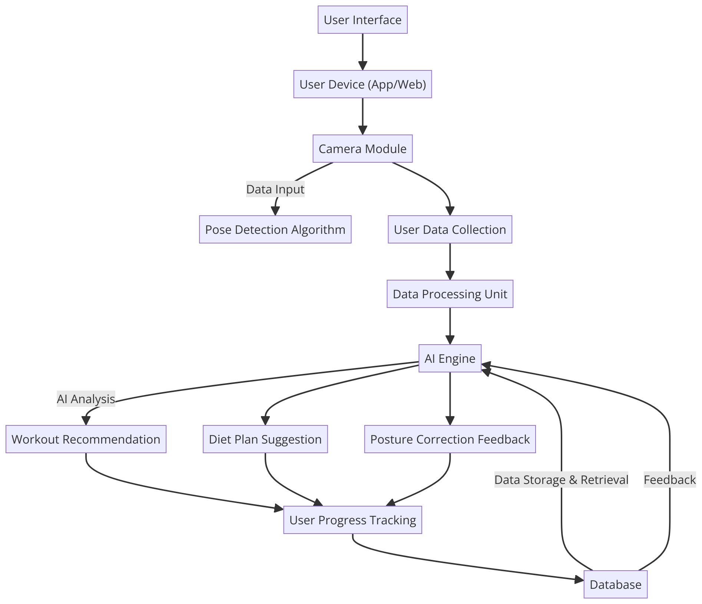
Idea of Implementation

Slide 14
Scope of project
The AI-based fitness platform aims to provide personalized fitness solutions by integrating artificial intelligence for workout recommendations, diet planning, and real-time posture correction. The scope includes:
Personalized Workout Plans: AI-generated exercise routines tailored to individual fitness levels, goals, and preferences.
Diet Plan Suggestions: AI-driven meal recommendations based on user health data and fitness objectives.
Real-time Posture Correction: Computer vision-based posture detection to guide users on maintaining correct form during exercises.
Progress Tracking: Monitoring user performance, progress, and adherence to workout and diet plans.
User-Friendly Web App: An interactive platform where users can access fitness insights, workout routines, and AI-driven guidance.

Slide 15
References
Chae, H. J., Kim, J. B., Park, G., O'Sullivan, D. M., Seo, J., & Park, J. J. (2023). An Artificial Intelligence Exercise Coaching Mobile App: Development and Randomized Controlled Trial to Verify Its Effectiveness in Posture Correction. Interactive Journal of Medical Research, 12, e37604.
Patil, S., & Patil, P. (2023). A Review on: Body Posture Detection and Motion Tracking using AI for Fitness Applications. Journal of Emerging Technologies and Innovative Research, 10(2), 456-460.
Sharma, A., & Gupta, R. (2021). AI-Based Workout Assistant and Fitness Guide. International Journal of Engineering Research & Technology, 10(7), 789-795.
Mahendran, N. (2021). Deep Learning for Fitness. arXiv preprint arXiv:2109.01376.
Chaudhari, H. P., Faras, A., & Patil, M. (2024). Virtual Fitness Trainer Using AI: A Research Paper. International Journal for Research in Applied Science & Engineering Technology, 12(5), 123-130.

Slide 16
Topic 3 : Data Download Duplication Alert System
Introduction
In today's digital landscape, unauthorized or redundant data downloads pose significant risks, including data breaches, storage inefficiencies, and compliance violations. The Data Download Duplication Alert System is designed to monitor, detect, and prevent duplicate downloads of sensitive files across an organization's network. By leveraging advanced algorithms and real-time monitoring, the system identifies repeated download attempts and alerts administrators, ensuring data integrity and security.
This system is particularly useful in preventing insider threats, reducing bandwidth wastage, and maintaining regulatory compliance. It can be integrated with existing data management frameworks and security protocols, offering seamless protection against redundant downloads. Through machine learning and behavioral analysis, the system continuously adapts to user patterns, distinguishing between legitimate and suspicious activities.

Slide 17
Literature Survey
Reference | Study Description | Key findings
AI/ML-Based Data Duplication Alert System (2023) | This research addresses the detection of redundant or duplicate data downloads in shared storage systems and large-scale networks. It proposes a machine learning-based approach to automate detection and provide real-time alerts, enhancing resource utilization. | The system effectively identifies duplicate data downloads, leading to improved storage efficiency and reduced processing costs. It emphasizes the importance of metadata analysis, including file names, sizes, and cryptographic hashes, in detecting duplicates.
Data Download Duplication Alert System (2023) | This project presents a practical implementation of a duplication alert system using technologies like React for the frontend, IPFS for decentralized storage, and Firebase for real-time data management. It aims to prevent redundant data downloads across various sectors. | The system successfully manages large datasets, prevents redundant downloads, and promotes efficient data sharing. It is applicable in academic institutions, research facilities, government agencies, and corporate environments.

Slide 18
Literature Survey
Reference | Study Description | Key findings
A Comprehensive Study of Present Data Deduplication (2022) | This paper provides an in-depth analysis of deduplication compression systems, detailing frameworks for duplicate and resemblance detection. It outlines the processes involved and discusses open problems and future research directions in data deduplication. | The study highlights the effectiveness of deduplication in reducing storage space and improving data management. It identifies challenges such as maintaining data integrity and the need for efficient detection algorithms.
Emerging Research Trends in Data Deduplication: A Bibliometric Analysis (2024) | This research conducts a bibliometric analysis of data deduplication studies from 2010 to 2023, examining aspects like annual scientific production, citations, and trending topics to understand the evolution of research in this field. | The analysis reveals a growing focus on cloud storage efficiency and the development of algorithms to manage duplicate data. It underscores the increasing importance of deduplication in handling large-scale data storage challenges.

Slide 19
Literature Survey
Reference | Study Description | Key findings
A Scheme for Data Deduplication Using Advanced Machine Learning (2022) | This study proposes a machine learning-based scheme to detect and eliminate redundant data in distributed architectures. It emphasizes the challenges of continuous data integration across multiple locations without cross-verification. | The proposed scheme enhances system efficiency and performance by effectively identifying and removing duplicate data entries, thereby optimizing storage utilization in distributed systems.

Slide 20
Idea of Implementation
Start (Begin the process)
User Requests to Download Data (User initiates a data download request)
Check for Previous Downloads (System verifies if the same file has been downloaded before)
If Duplicate Exists →
Trigger Alert & Ask for Confirmation (Notify the user about duplication and request confirmation)
If No Duplicate Exists →
Proceed with Download (Allow the user to download the file)
Log the Download Activity (Record the download details for future reference)
Continue Monitoring for Future Downloads (Keep tracking new download requests for duplication detection)
End (Process completes)

Slide 21
Scope of project
The Data Download Duplication Alert System aims to enhance data management and security by preventing redundant file downloads within an organization. By leveraging advanced monitoring techniques, the system ensures efficient resource utilization, reduces unnecessary storage consumption, and minimizes security risks associated with unauthorized duplicate downloads.
Real-Time Detection & Prevention: The system continuously monitors download activities, identifies duplicate file requests, and alerts users before allowing redundant downloads.
Optimized Storage & Bandwidth Usage: By preventing unnecessary duplication, the system helps organizations save storage space and optimize network bandwidth, improving overall system performance.
Security & Compliance Assurance: Ensures data integrity by restricting unauthorized or repetitive downloads, maintaining audit logs for compliance purposes, and reducing risks of data breaches.

Slide 22
Thank You

